Slide 1

Data Description
Session 1
M. Kachour

Slide 2
Terminology
Population is said to be finite if we can determine the exact number of its individuals (otherwise it is said to be infinite)
Individual (an element of the population)
Population: a set of elements sharing one or more characteristics that are used to group them together

Slide 3
Note

Slide 4
Terminology
A population is finite if the number of its individuals is finite
A population is infinite if we cannot determine the "exact" number of its individuals.

Slide 5
Note

Slide 6
Terminology
Population | Finite | Infinite
ESSCA students in the first year for the class of 2020
Cars that pass at a crossroads between 10am and 3pm

Slide 7
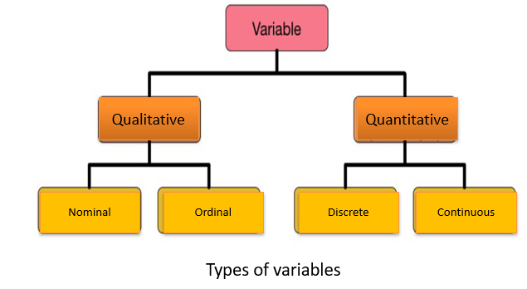
Terminology

Slide 8
Note

Slide 9
Examples
Find the type / nature of the variables below:
Hair color of hair salon customers →
The level of customer satisfaction of a telephone operator →
The number of people in Parisian households →
The "exact" waiting time on the phone of customers before being answered by the technical service of an internet provider →

Slide 10
Note

Slide 11
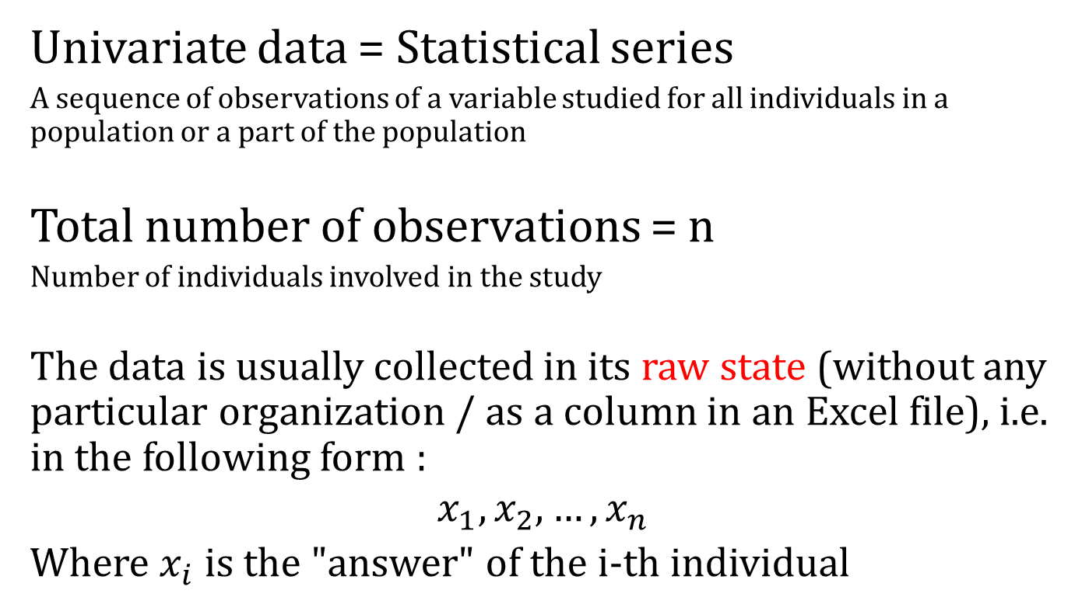
Data representation
Univariate data = Statistical series
A sequence of observations of a variable studied for all individuals in a population or a part of the population
Total number of observations = n
Number of individuals involved in the study
The data is usually collected in its raw state (without any particular organization / as a column in an Excel file), i.e. in the following form :
$$x_{1}, x_{2}, …, x_{n}$$
Where $x_{i}$ is the "answer" of the i-th individual

Slide 12
Note

Slide 13
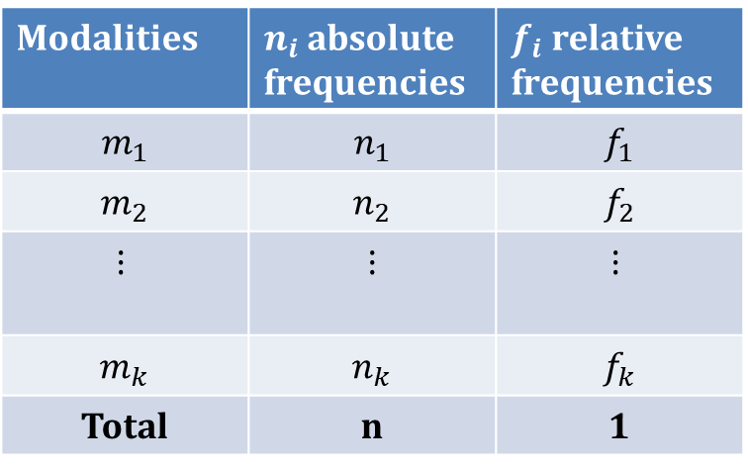
Table summary
A modality is a category of answers obtained/observed
There are k modalities, where k is an integer between 1 and n
The modalities are arranged in ascending order. Except for nominal qualitative variables (no order for modalities)
Modalities | $n_{i}$ absolute frequencies | $f_{i}$ relative frequencies
$m_{1}$ | $n_{1}$ | $f_{1}$
$m_{2}$ | $n_{2}$ | $f_{2}$
$$⋮$$ | $$⋮$$ | $$⋮$$
$m_{k}$ | $n_{k}$ | $f_{k}$
Total | n | 1

Slide 14
Note

Slide 15
Example 1
Qualitative nominal variable
The following data represents the gender of 24 candidates to a competition :
H, H, F, H, F, H, H, F, H, F
H, F, H, F, H, F, H, H, H
F, H, F, H, H
Gender | Number of candidates | Frequencies
Total | 24 | 1

Slide 16
Example 2
Qualitative ordinal variable
The following data represents the level of study of 24 candidates to a competition :
L, L, M, M, L, L, L, L, M, D
L, L, L, L, L, M, L, L, L
L, L, L, L, D
Level of study | Number of candidates | Frenquency
Total | 24 | 1

Slide 17
Example 3
Quantitative discrete variable
We consider the grade (out of 20) of 24 candidates in a competition:
11 ; 13 ; 8 ; 16,5 ; 11 ; 7 ; 13 ; 12 ; 11 ; 12 ; 12 ; 8 ; 11 ; 8 ; 12 ; 11 ; 7 ; 16,5 ; 8 ;
11 ; 8 ; 12 ; 8 ; 16,5
Grade | Number of candidates
Total | 24

Slide 18
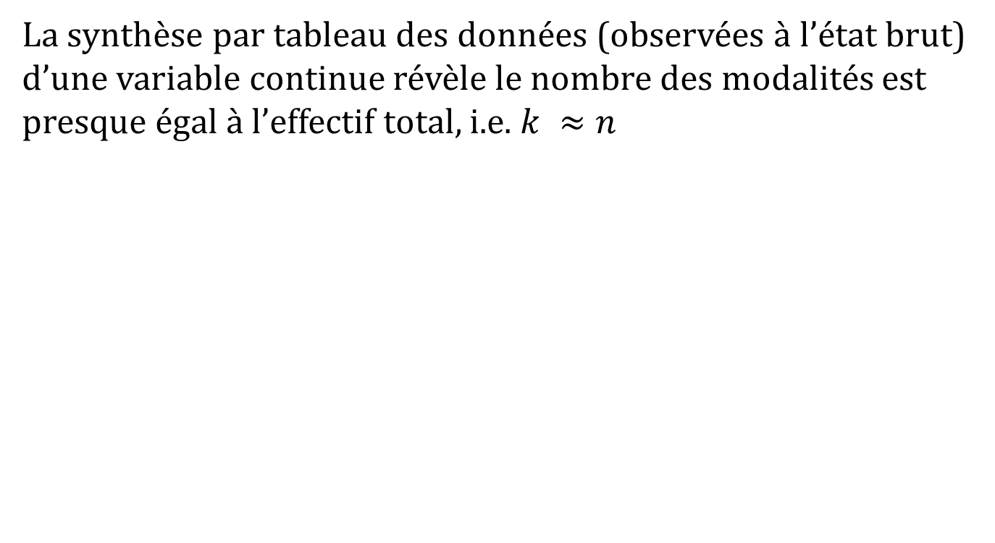
Data synthesis of a continuous variable
The tabular synthesis of the data (observed in the raw state) of a continuous variable reveals that the number of modalities is almost equal to the total number, i.e. k ≈n
The observations are almost all different
At this point, the table synthesis does not bring any added value !!!

Slide 19
Note

Slide 20
Data synthesis of a continuous variable
Solution →
Splitting / Grouping of data into classes / intervals
Splitting via mathematical methods/tools
Splitting based on predefined / imposed classes (by the problem treated and / or by prior information concerning this problem)

Slide 21
Note

Slide 22


Example
Data synthesis of a continuous variable
The data below represents the current monthly net
salary (rounded to nearest hundredth) of 24 candidates to a competition :
Net salary | Number of candidates
Total | 24
We decided to synthesize the data according to the modalities below :

Slide 23
Continuous variable "discretized" data (upstream)
Remark:
In practice (in the context of a survey for example), continuous variables are discretized beforehand. Explicitly, the "data scientist" divides in advance the set of possible values of the continuous variable into intervals (modalities).
He (she) asks the participants to situate themselves regarding these intervals. This splitting is often based on the needs of the study on the one hand, and prior knowledge of the variable and the population studied on the other.

Slide 24
Note

Slide 25
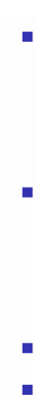
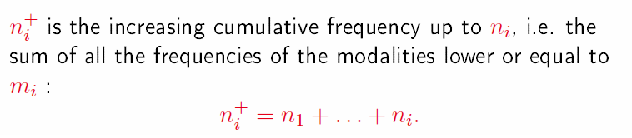
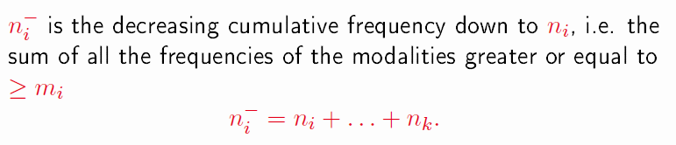

Operations

Slide 26
Note

Slide 27


Application – Back to examples
Calculate $n_{i}^{+}$, $f_{i}^{+}$, $n_{i}^{−}$, et $f_{i}^{−}$ of the data presented in the table below:
The Level of Study
Number of candidates

Slide 28
Note

Slide 29
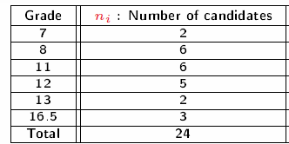
Application – Back to examples
Calculate $n_{i}^{+}$, $f_{i}^{+}$, $n_{i}^{−}$, et $f_{i}^{−}$ of the data presented in the table below:

Slide 30
Note

Slide 31
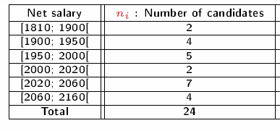
Application – Back to examples
Calculate $n_{i}^{+}$, $f_{i}^{+}$, $n_{i}^{−}$, et $f_{i}^{−}$ of the data presented in the table below:

Slide 32
Note

Slide 33
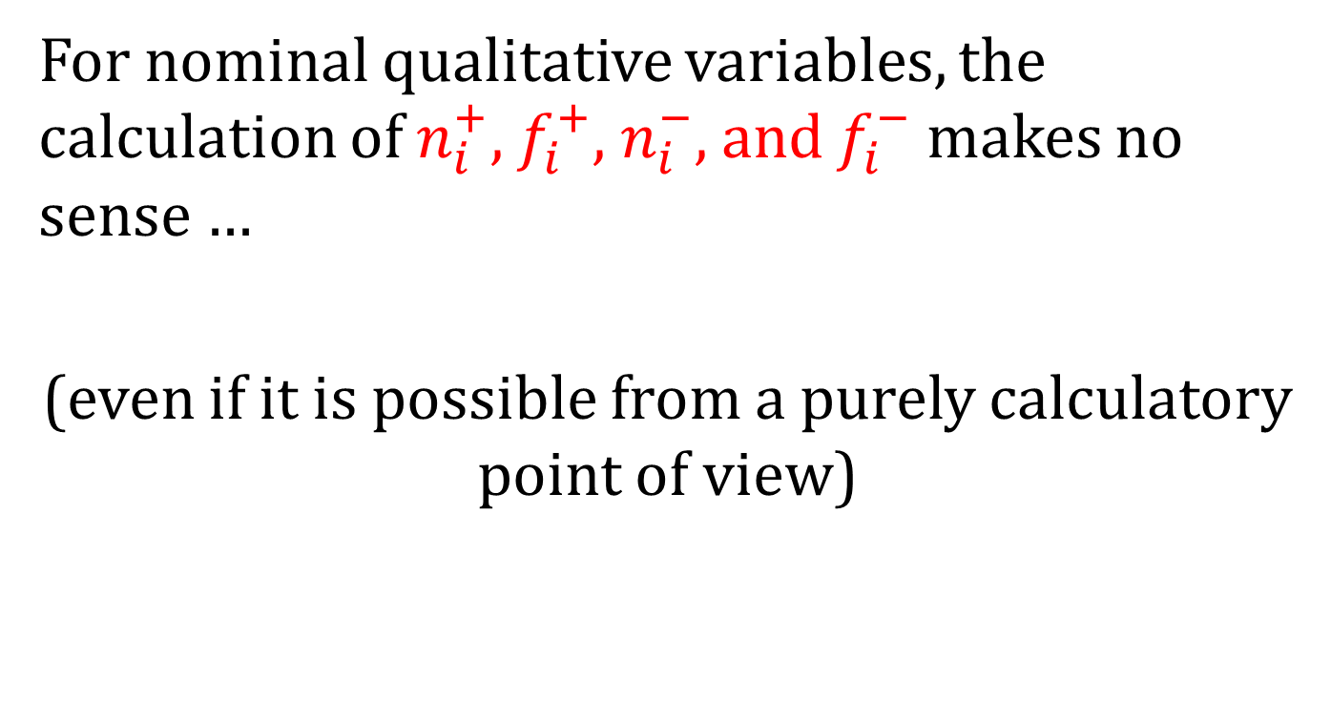
Remark
For nominal qualitative variables, the calculation of $n_{i}^{+}$, $f_{i}^{+}$, $n_{i}^{−}$, and $f_{i}^{−}$ makes no sense …
(even if it is possible from a purely calculatory point of view)

Slide 34
Note

